Slide 1
Keylogger in the background
Niaz Prodhan
UCB BootCon | 12/19/2022

Slide 2

Keylogger
Software that logs user Keystrokes
Happens without user permission or knowledge
Logs sent back to the attacker

Slide 3
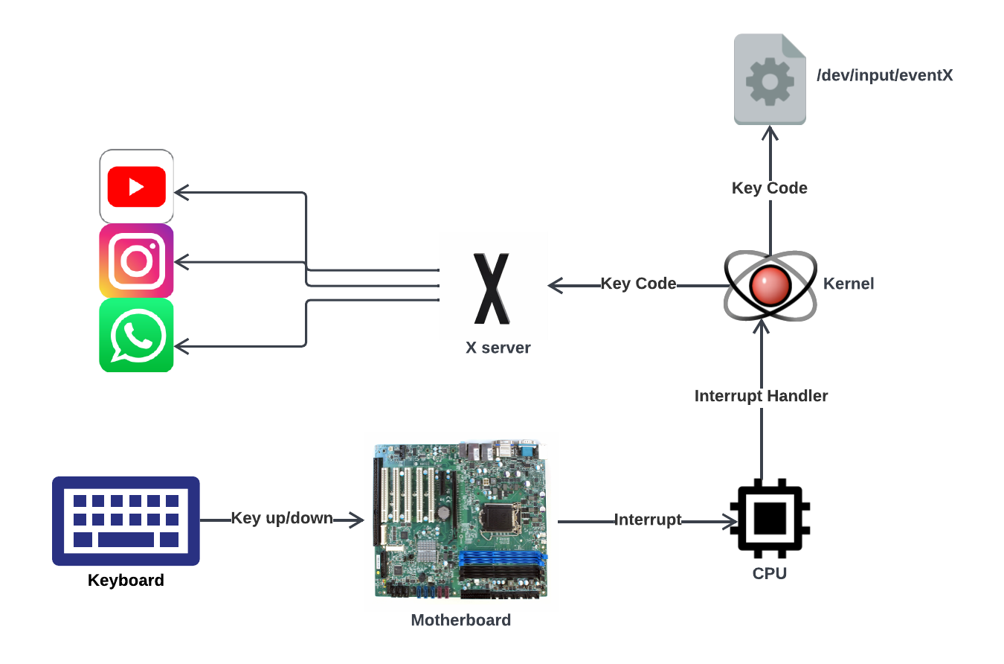
Technical Background
Keyboard sends key press/release to Motherboard as unique byte AKA Key Code.
Motherboard sends Interrupt signal to CPU.
CPU launches IH against the Interrupt, sends signal to Kernel.
Kernel sends Key Code to X for GUI Apps.
Kernel sends Key Code to /dev/input/eventX files.

Slide 4
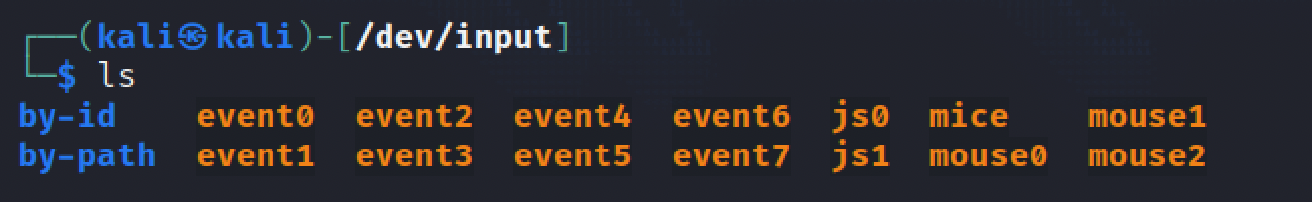
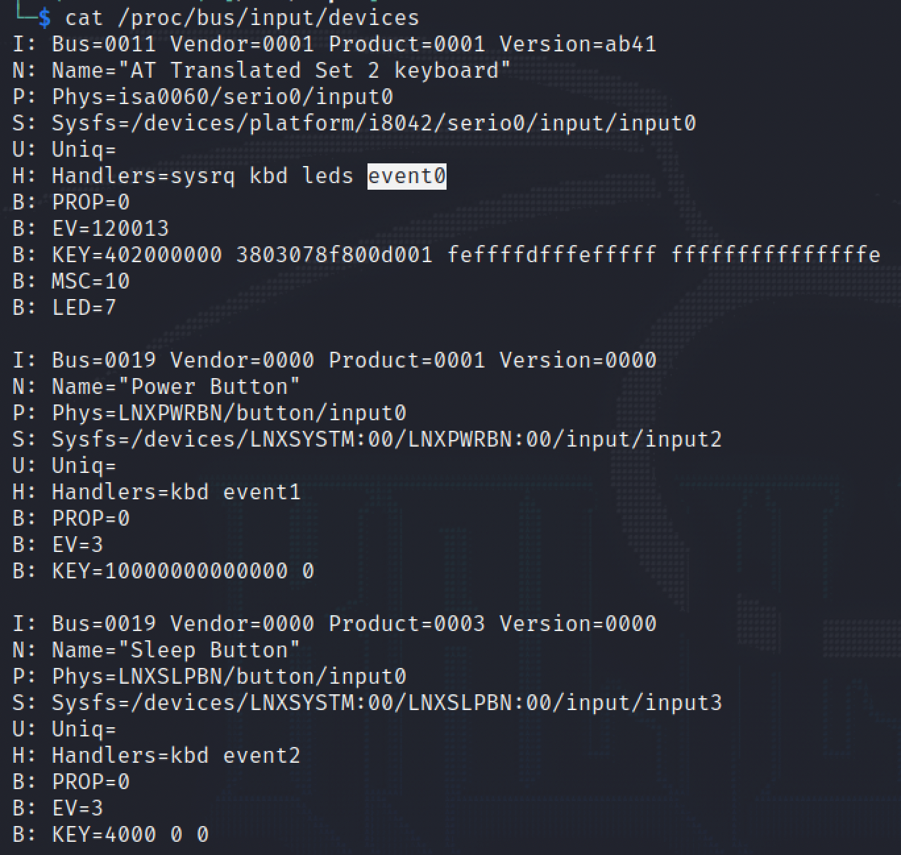
Technical Background
/dev/input/eventX
cat /proc/bus/input/devices
Event0 mapped to Keyboard
Event1 mapped to Power Button
Event2 mapped to Sleep Button

Slide 5
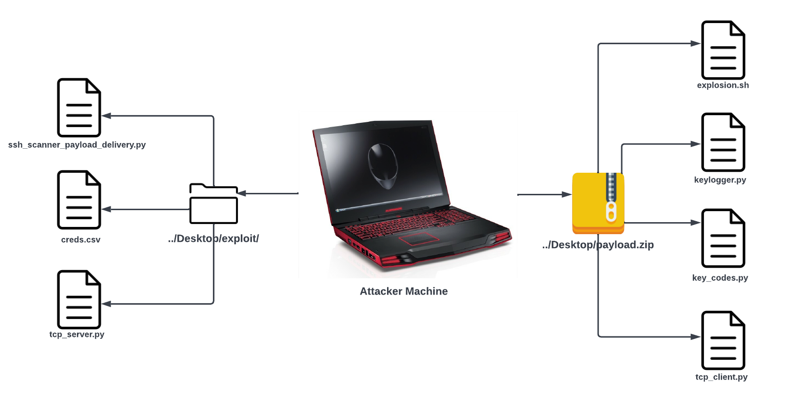
Demo Preview
Nmap Network to find machine running SSH
ssh_scanner_payload_delivery.py attempts to brute force SSH by credentials in creds.csv
tcp_server.py waits for client sending log files over TCP

Slide 6
Demo Preview
explosion.sh - A bash script, the cockpit of payload
keylogger.py - The Keylogger program, logs keystrokes by reading /dev/input/eventX
key_codes.py - Decimal key codes mapped to char
tcp_client.py - Runs via cronjob, transfers log files generated by the Keylogger.

Slide 7

Demo Preview
payload.zip transferred to Victim Machine over SSH

Slide 8
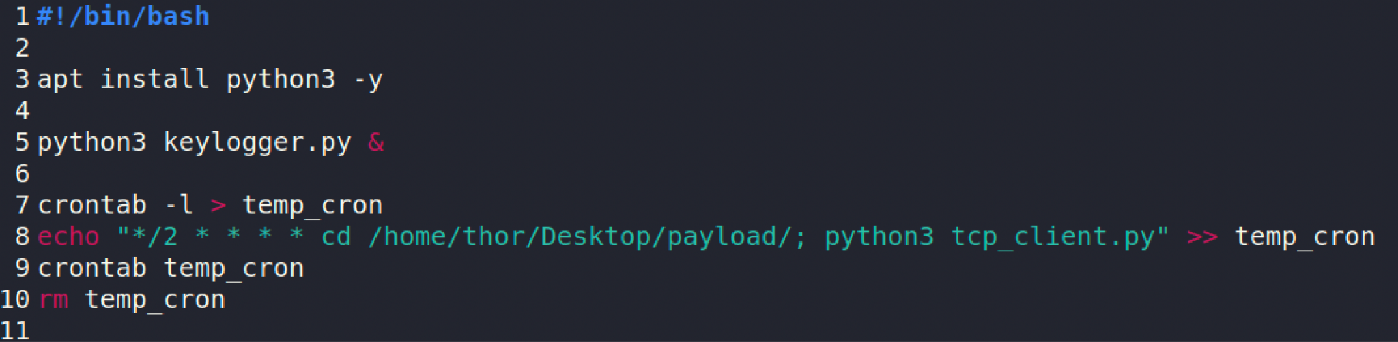
Demo Preview
Installing Python3
Running keylogger.py in the background
Creating cron job to send generated log files to the Attacker Machine via tcp_client.py
All codes are available https://github.com/niaz-ahsan/Keylogger-in-the-Background

Slide 9
Demo
Watch it on youtube:
https://www.youtube.com/watch?v=gFgk_dB6Jfo

Slide 10
Demo Summary
Found a machine running SSH via nmap scan
Performed Brute Force by SSH with provided credentials
Delivered keylogger payload over SSH
Initiated keylogger in the victim machine via bash script
Received generated logs from victim machine over TCP

Slide 11
Mitigation
Protect SSH server with SSH key connection
Passphrase must not remain blank
Limit login access attempts. Inside sshd_config
MaxAuthTries is limited
Turn off TCP Port Forwarding and X11 Forwarding. Make sure in sshd_config
X11Forwarding no
AllowTcpForwarding no
IP Restrictions. Inside /etc/hosts.allow
Allow specific IP block, or single IP to get access to the machine

Slide 12
The End
Throw me your queries.

